Slide 1
Giggles Gears
ST1516 – DevOps & AI Automation
Jeyakumar Sriram
DAAA/FT/2B/01
2214618
Where you can find you future car…

Slide 2
Table of contents
01
02
03
04
05
06
Application
DevOps Process
Regression
Flask
Testing
Advanced

Slide 3
01
Application

Slide 4
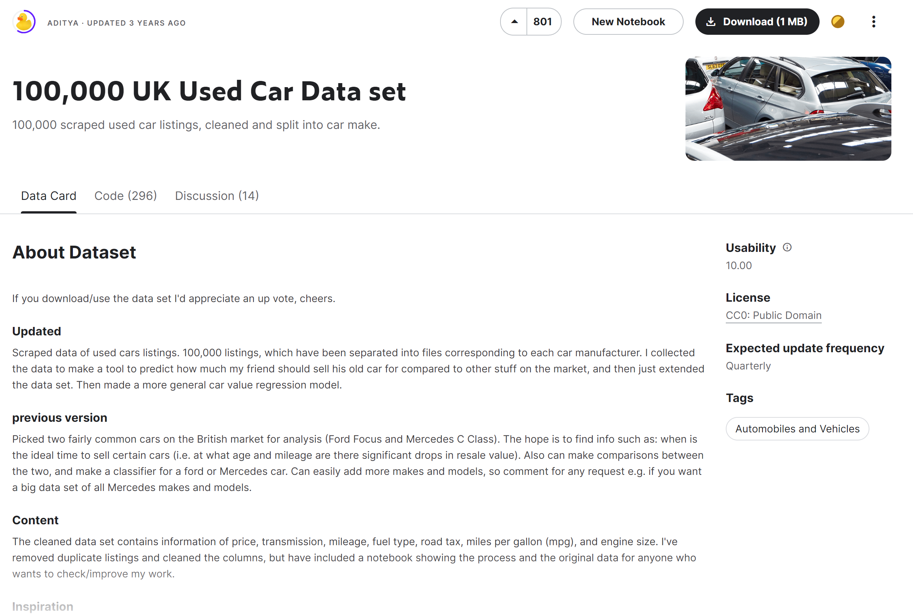
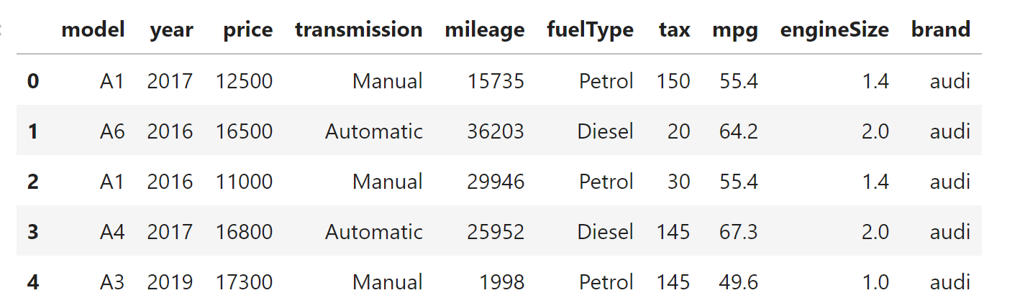
The Dataset
This dataset consists of prices and other related information on a 100000 cars from the UK. Since this dataset is from the UK most of the brands are from there.
I had to join and clean them to properly format to one df

Slide 5

Application Demo
The application I built has the following key features.
Users can:
browse a catalogue of cars available for resale
add their desired cars to a wishlist
get a rough estimate of how much a car with their desired features would cost
get 3 recommended cars based on their input on desired features
view and delete their prediction history
view and delete items from wishlist
sign up or login to save their progress
view and modify their profile
https://giggles-gears.onrender.com/

Slide 6
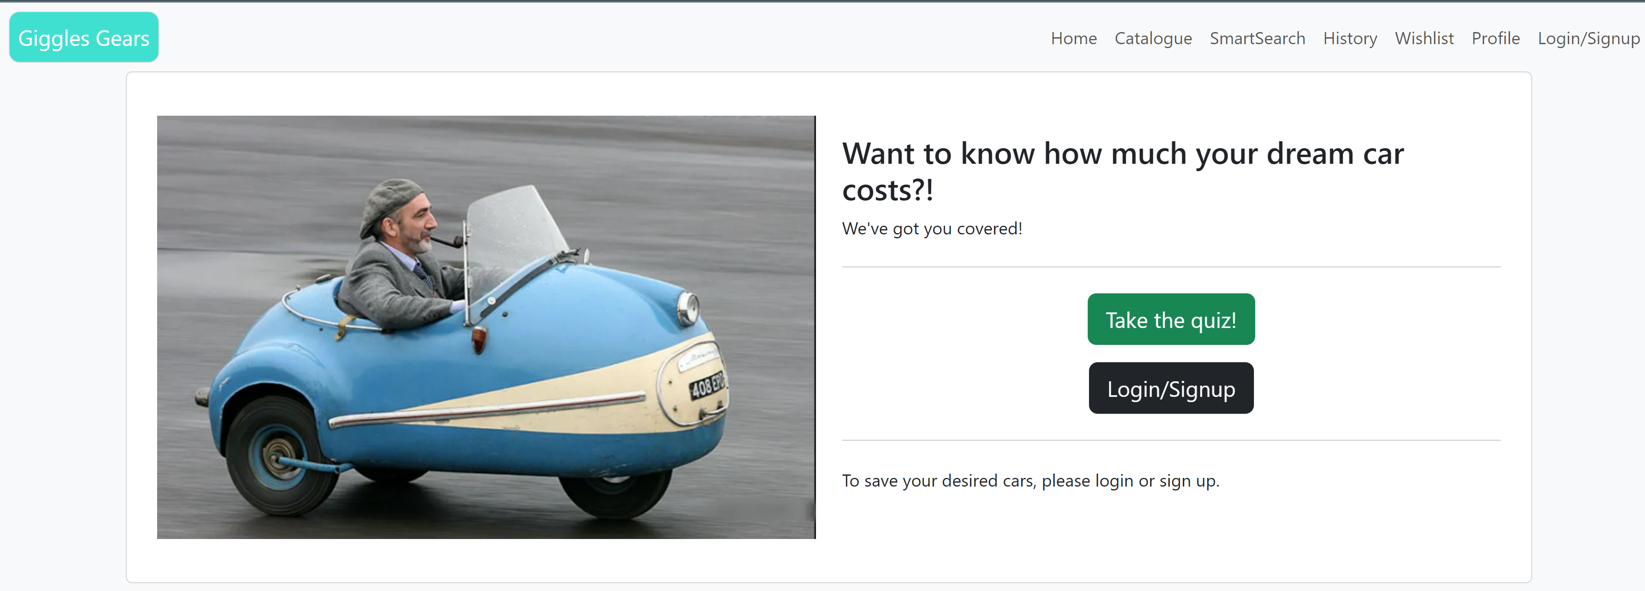
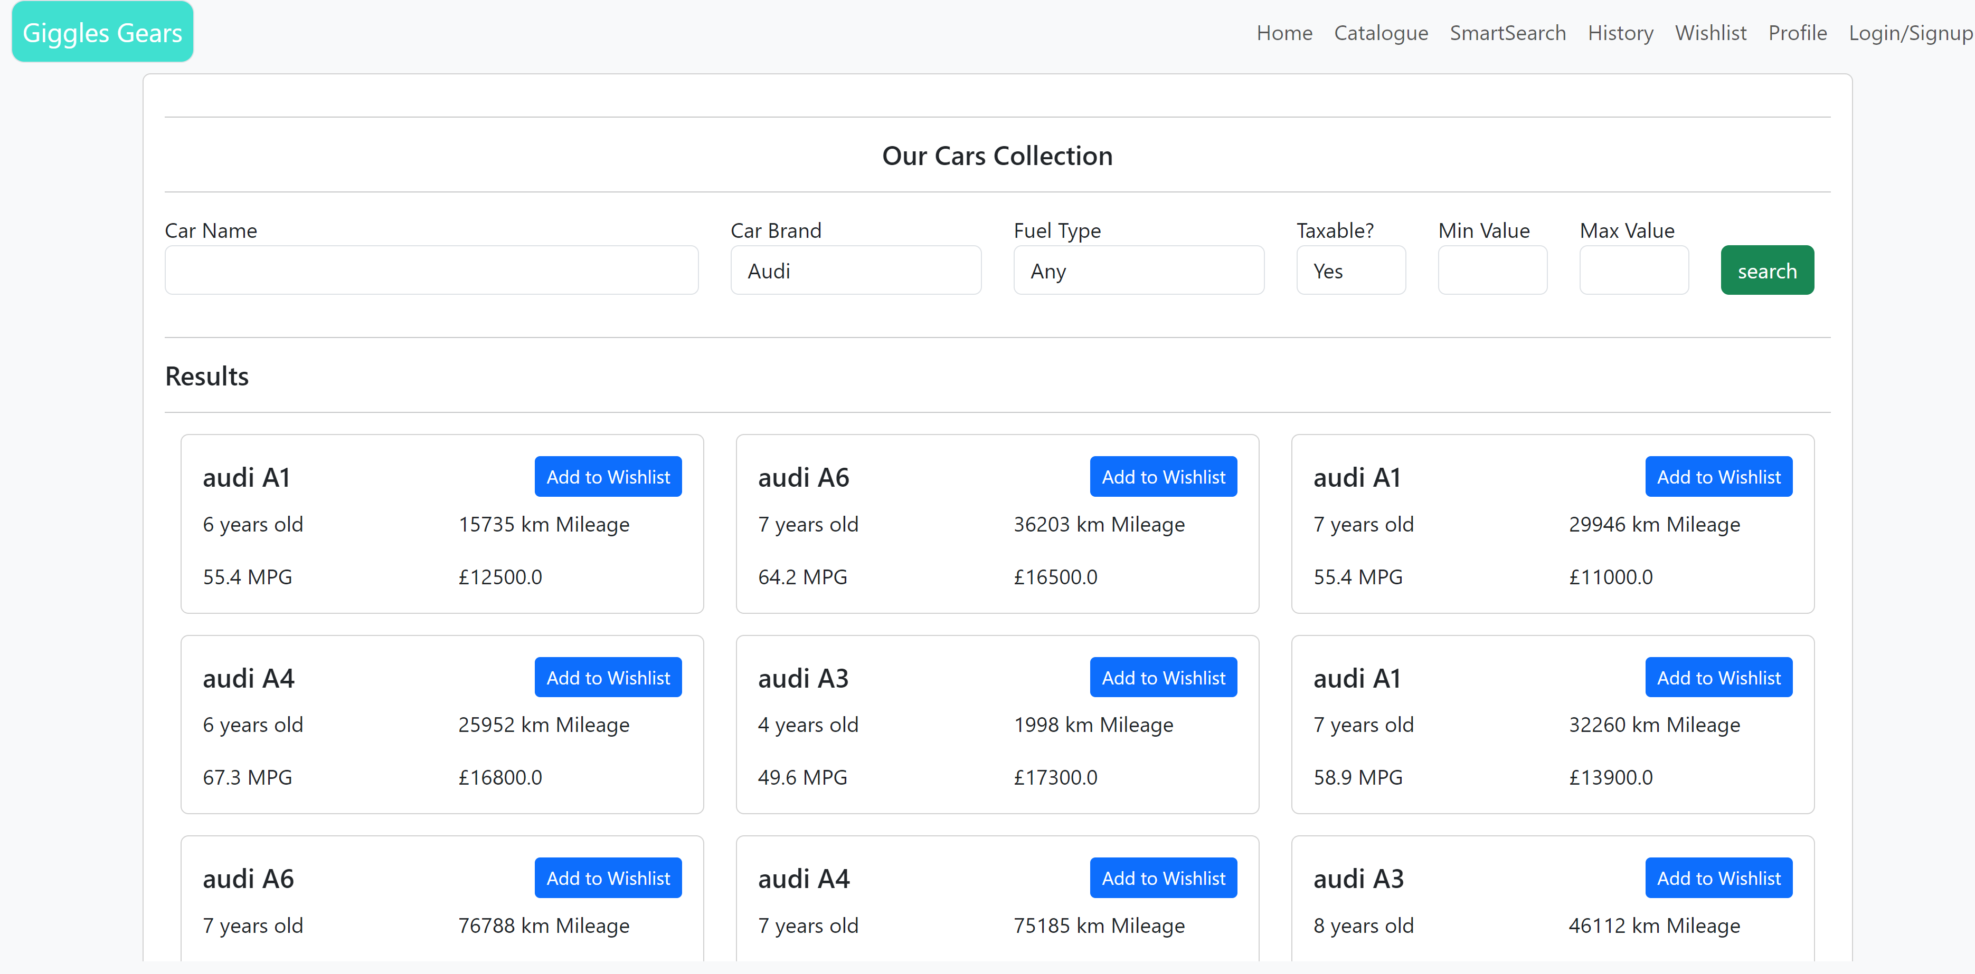
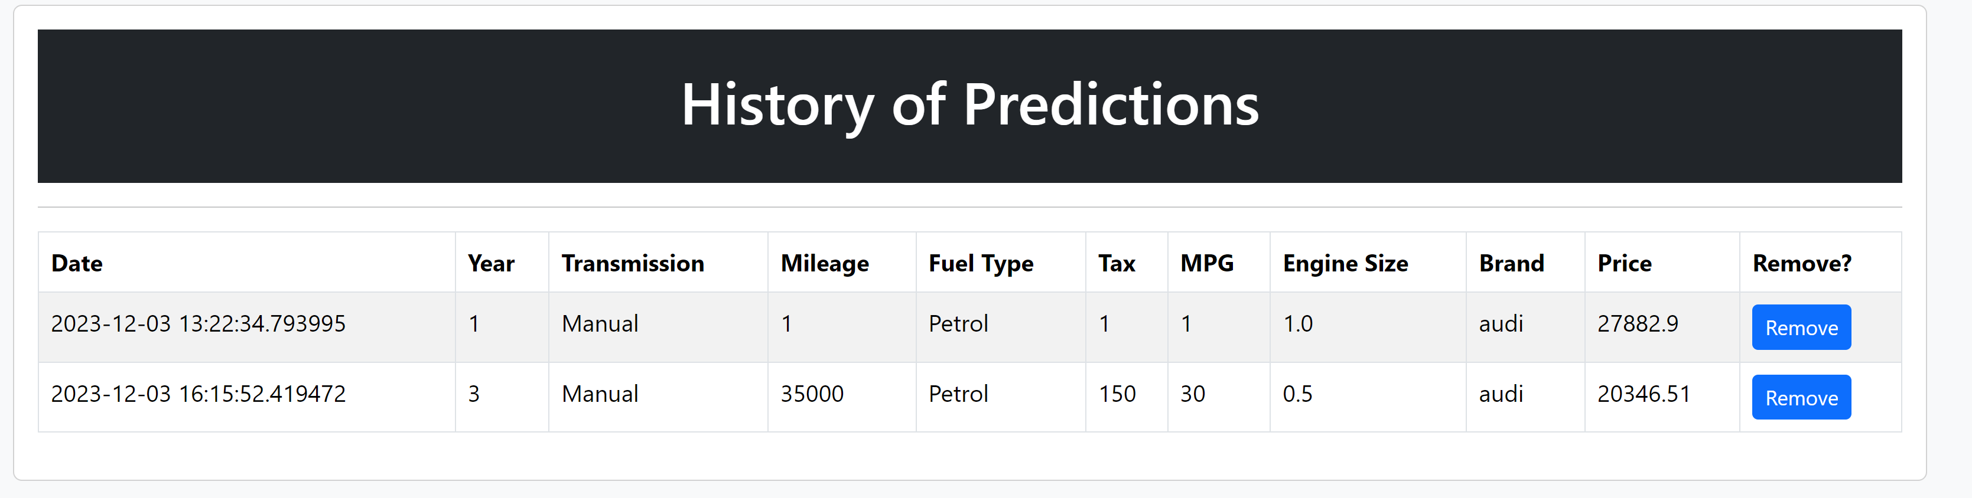
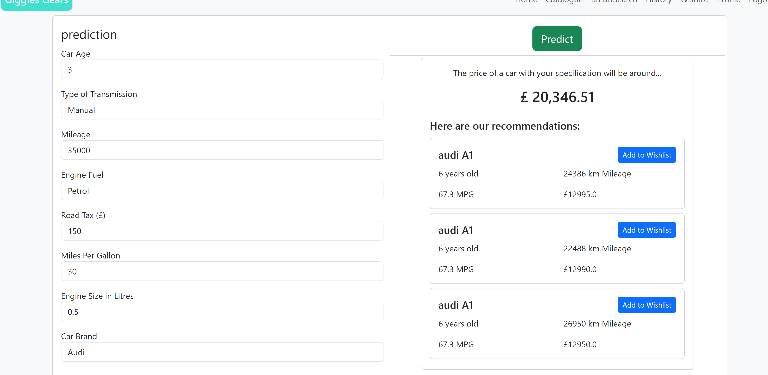
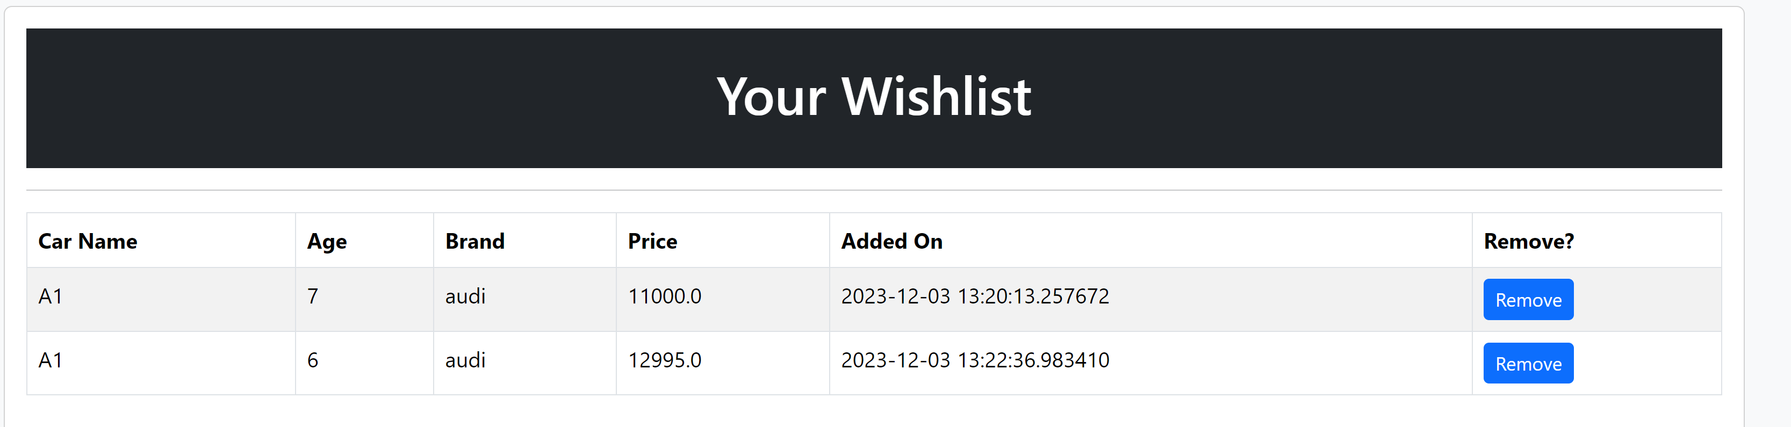
Some pictures

Slide 7
02
DevOps Process

Slide 8
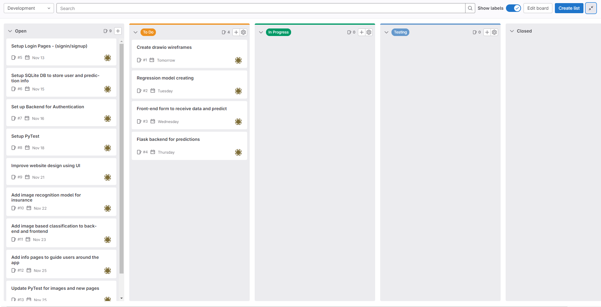
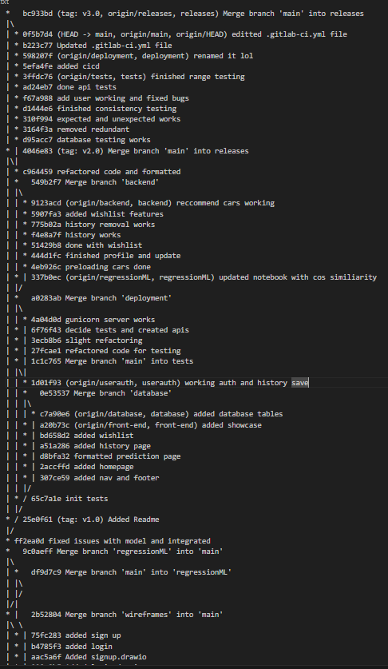
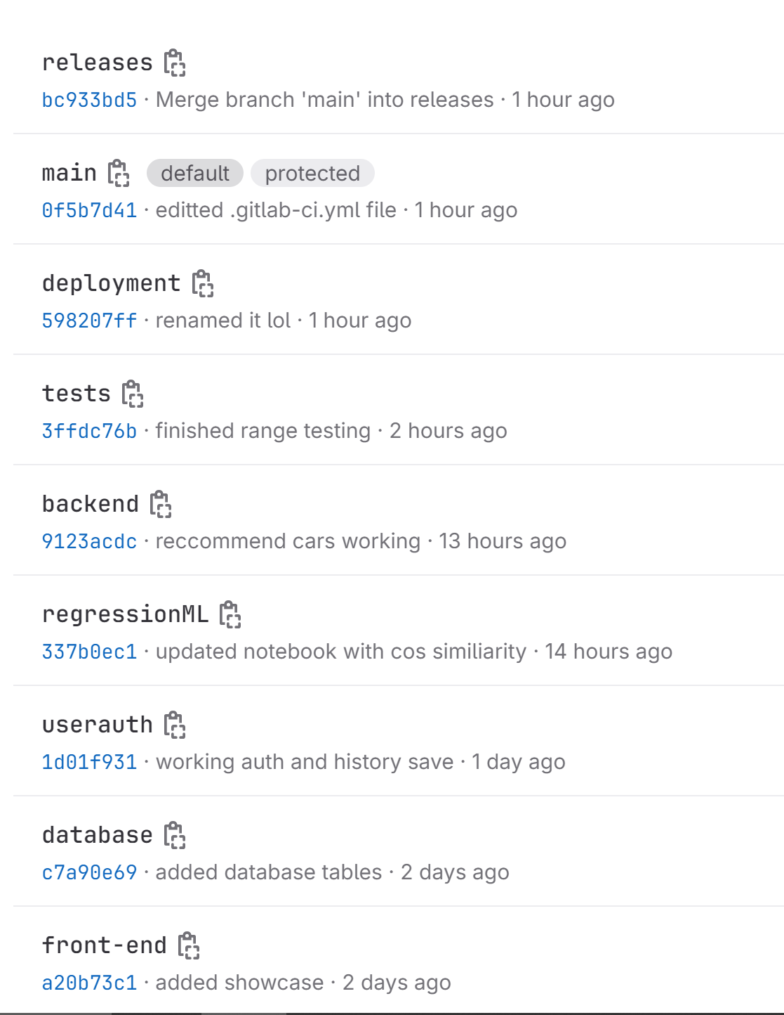
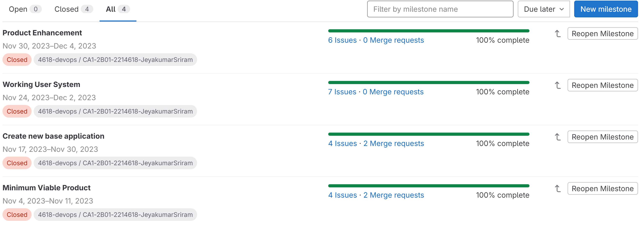
Git & Scrum
Issue List -> Scrum Board
Git Commits
Branches
Releases branch has fully working user ready products. Main is more like a development branch. I’m using the centralized workflow from notes
Each issue has a user story if you read the description. Each issue has a deadline and a sprint assigned. “Open” section is my product backlog. “To Do” is my sprint backlog
Milestones -> Sprints
Since I changed my dataset halfway I had to create a sprint to adapt my code to the new data

Slide 9
03
Regression

Slide 10
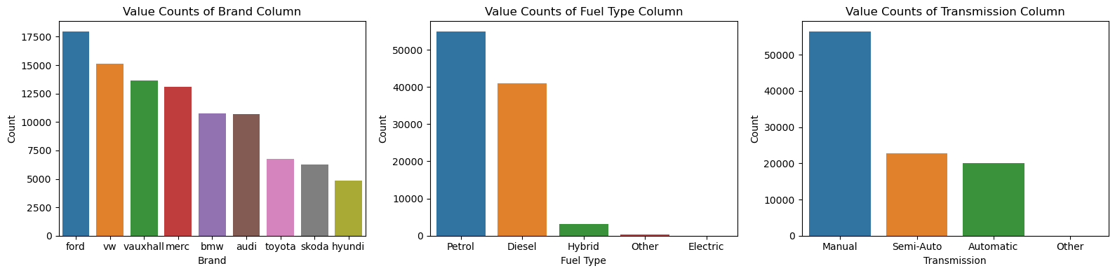
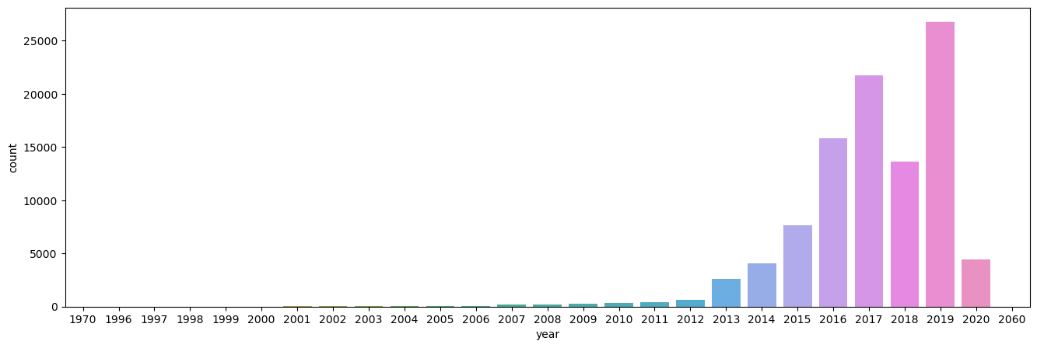
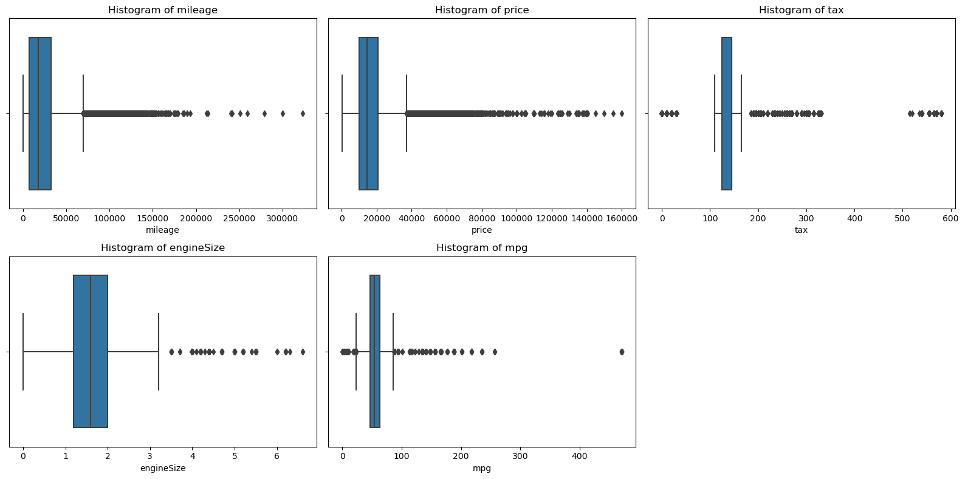
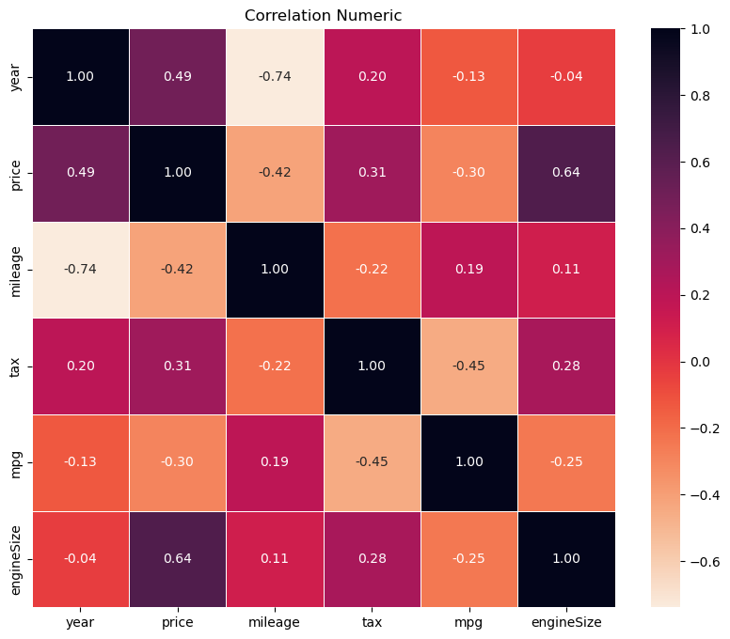
Exploratory Data Analysis
Based on the EDA:
Some classes had very low rows and decided to remove them.
Outliers in year and other numeric columns
Price highly correlated with year and engine size
No null values
Model has too many classes and cannot be used

Slide 11
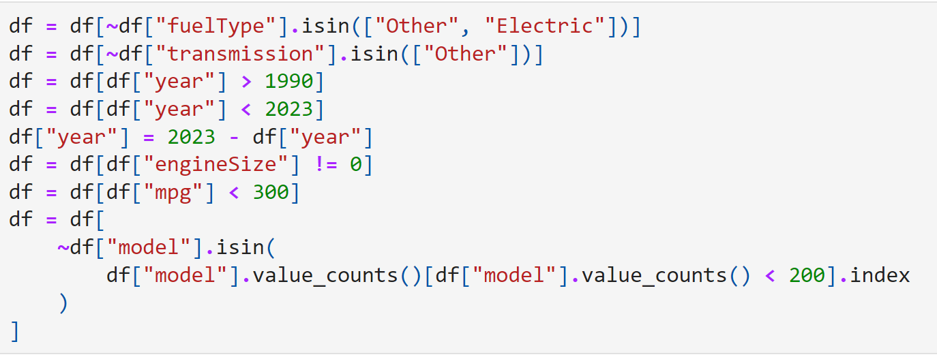
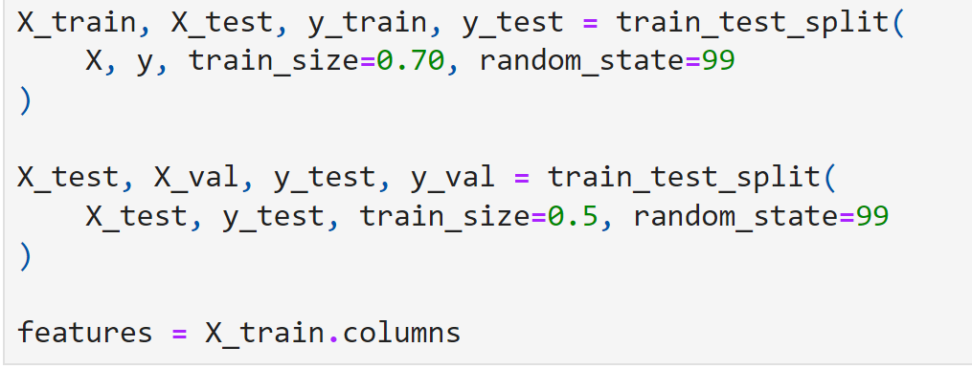
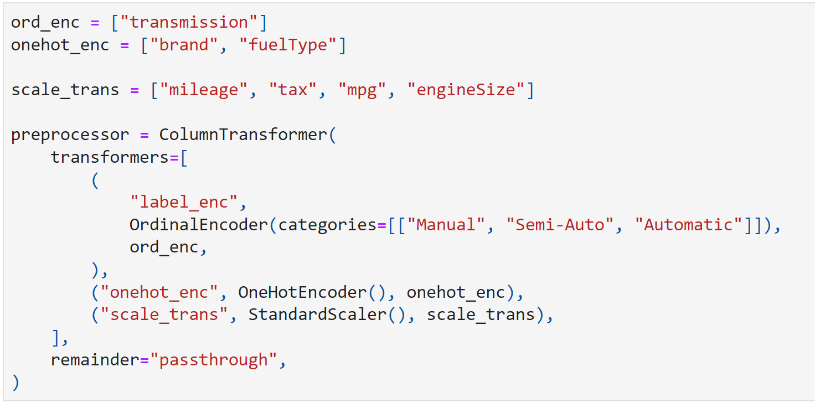
Preprocessing
Cleaning
Splitting
Pipeline
Removed outliers
Remove classes with low representation
Removed models with very little rows
Used train-val-test split with ratio 70-10-10
Dropped model column from dataset
Performed ordinal encoding for transmission
Performed one hot for others
Scaled numeric columns

Slide 12
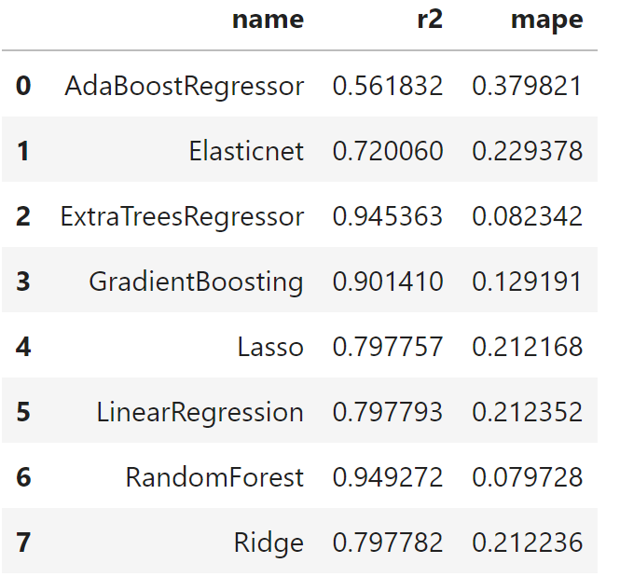
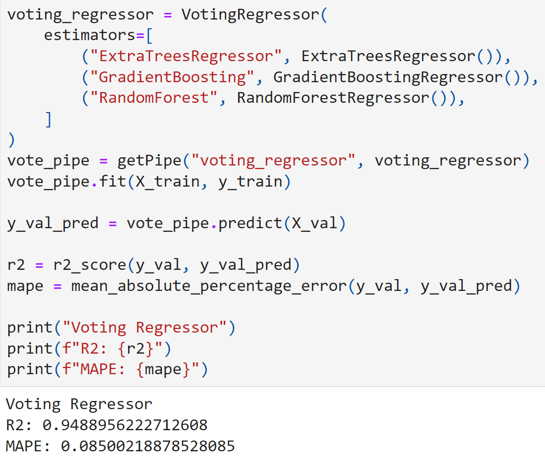
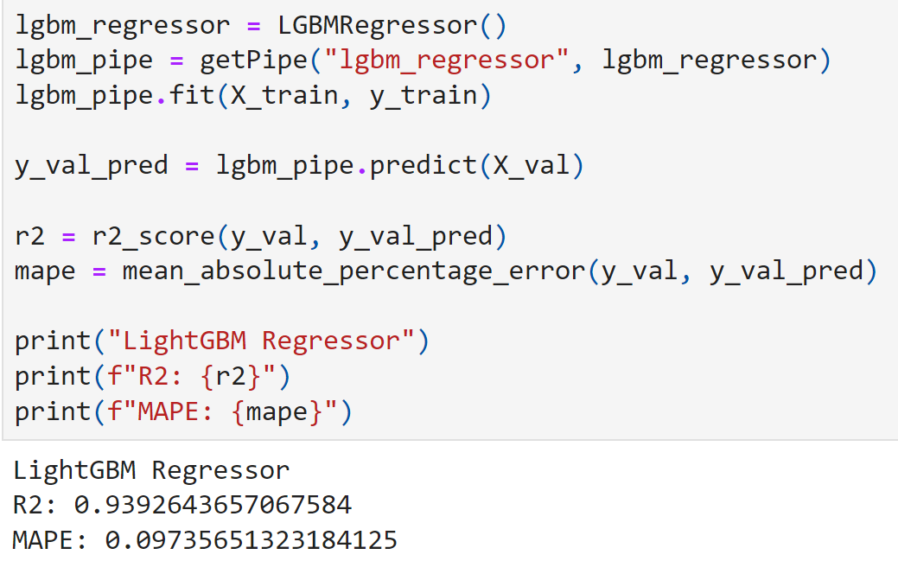
Modelling
Try many
VotingRegressor
LightGBM
Compared r2 and MAPE from various models
Random Forest, ExtraTrees and Gradient Boosting performed well on val
Used three best models just now to make it
Performed around the same
But takes very long to train and predict
Used from external library
Performed around the same
But is noticeably faster

Slide 13
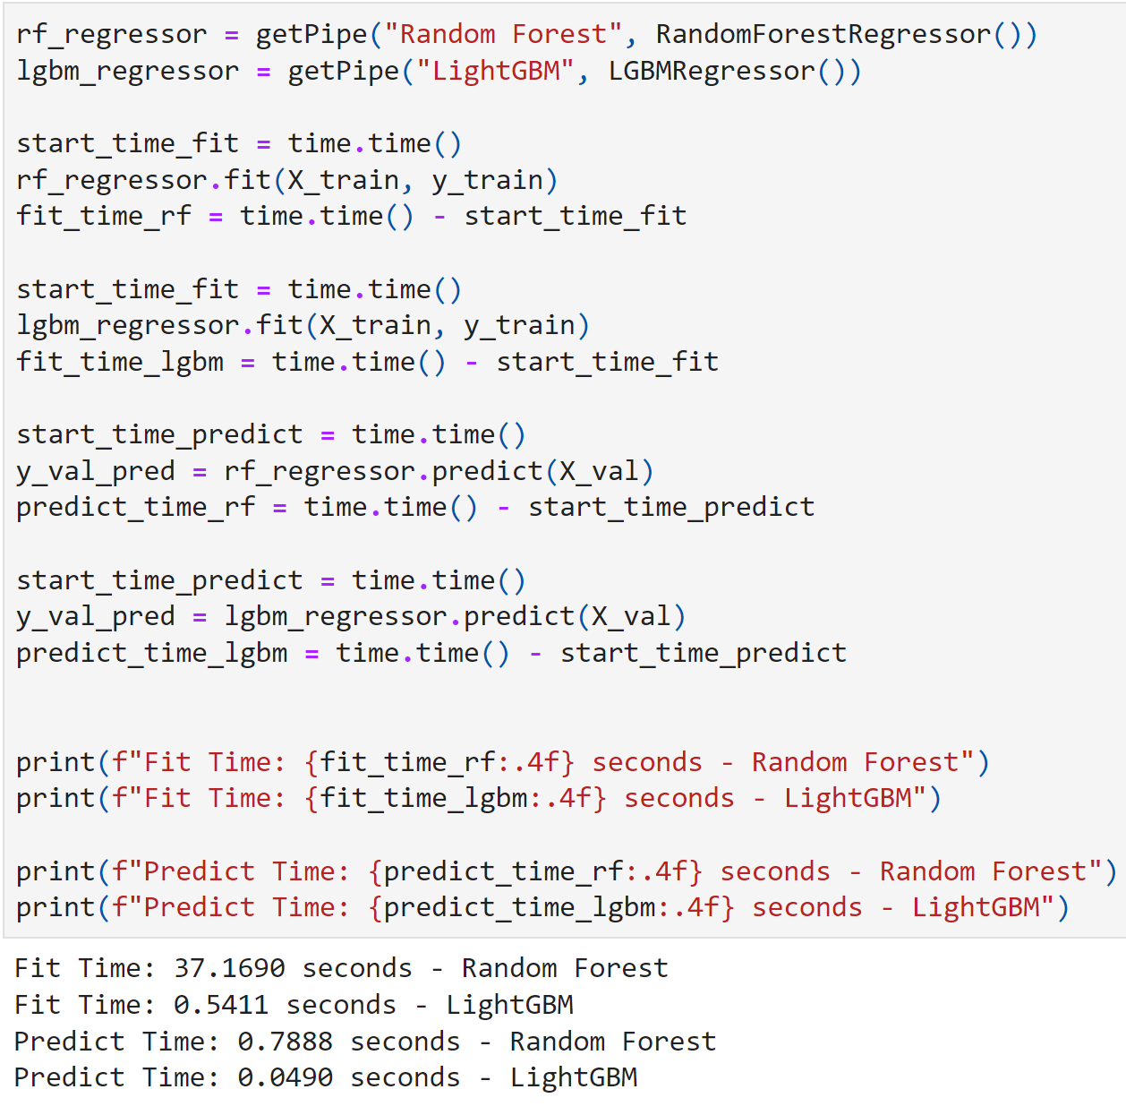
Random Forest vs LightGBM
Random Forest
LightGBM
Performed slightly better than LGBM
Slower than LGBM
More accuracy might not be that significant to user than speed
Performed slightly worse than RF
40x faster at training
20x faster at prediction
Will provide better user experience

Slide 14
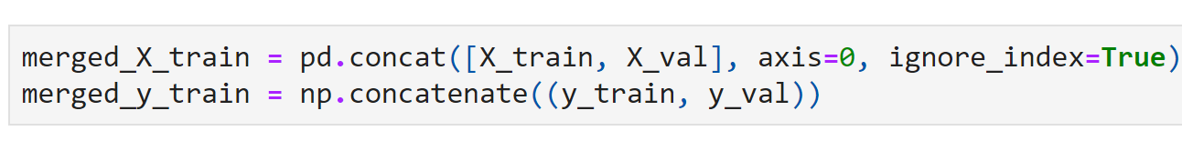
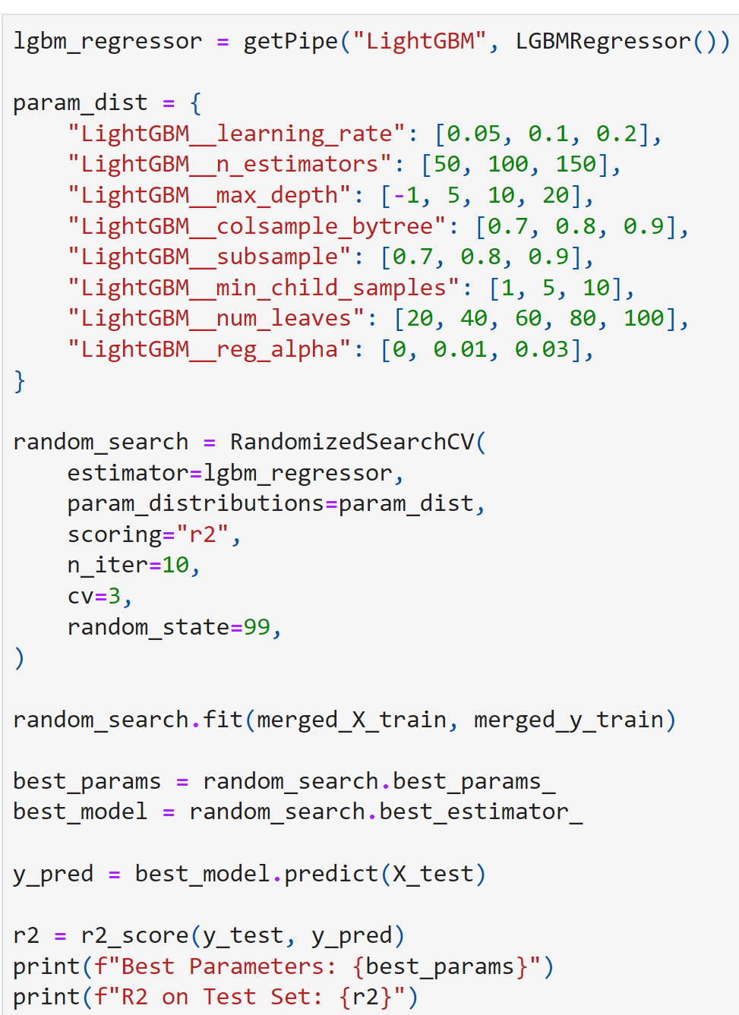
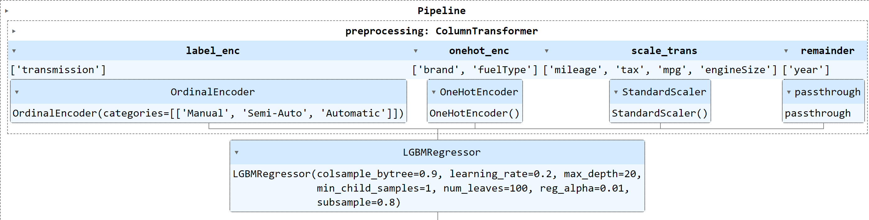
Tuning & Final Model
Since we making final model I will use the entire dataset without splits
Use RandomisedCV for speed as the slight increase in accuracy with GridsearchCV may not be significant
Best r2 is better than RF just now
Final pipeline is ready and will be saved as pickle file to be loaded by Flask

Slide 15
04
Flask

Slide 16
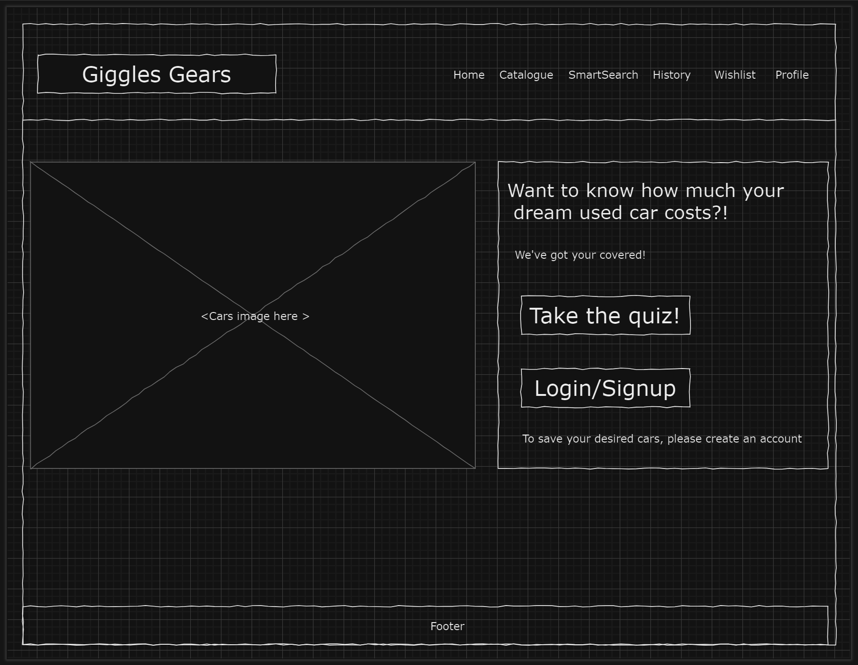
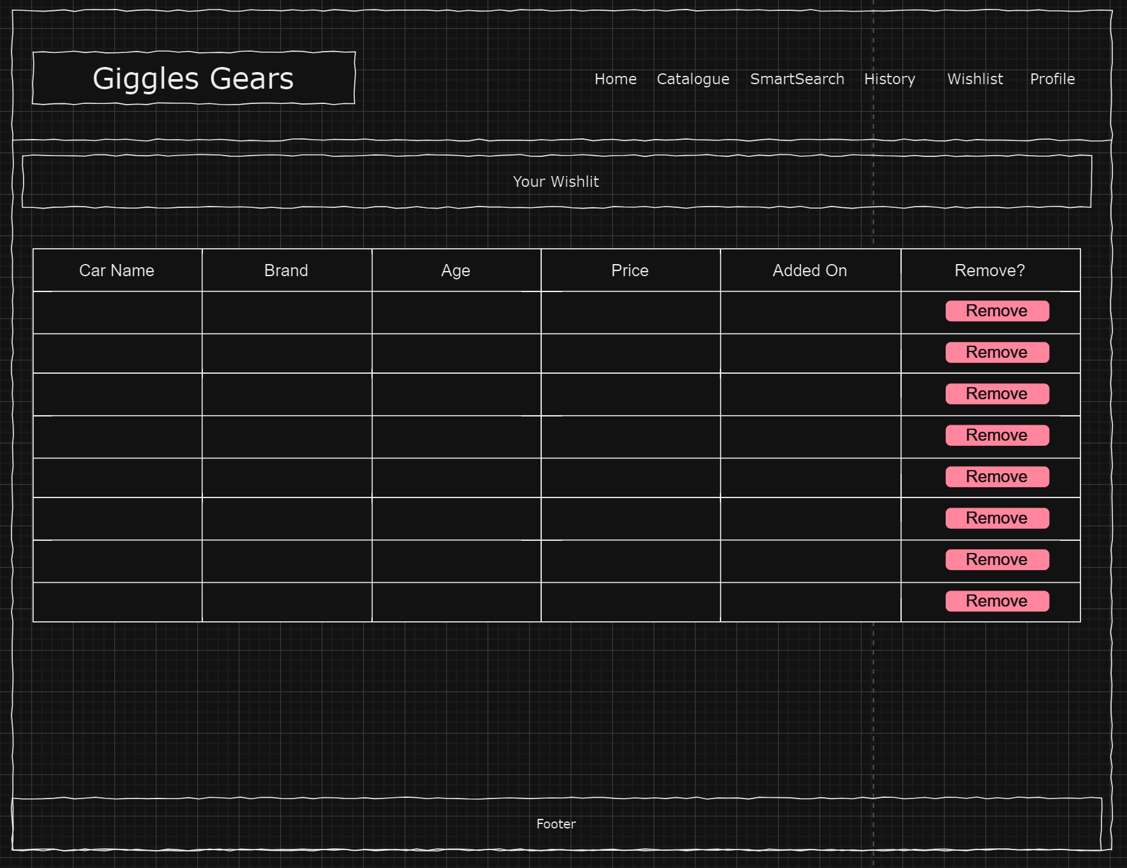
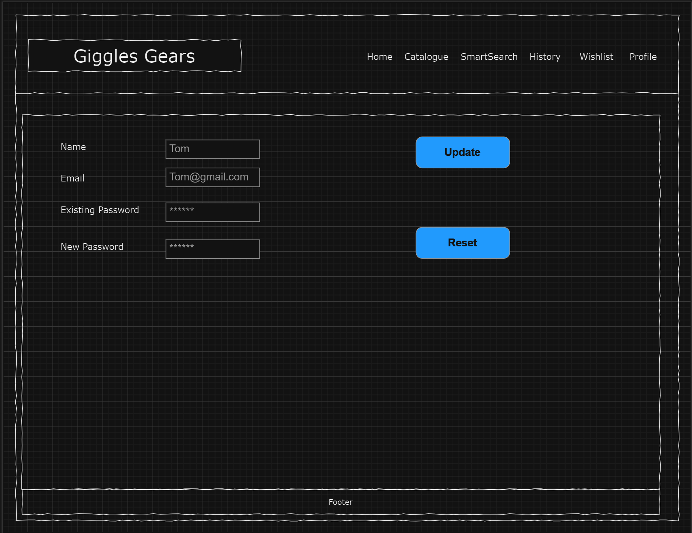
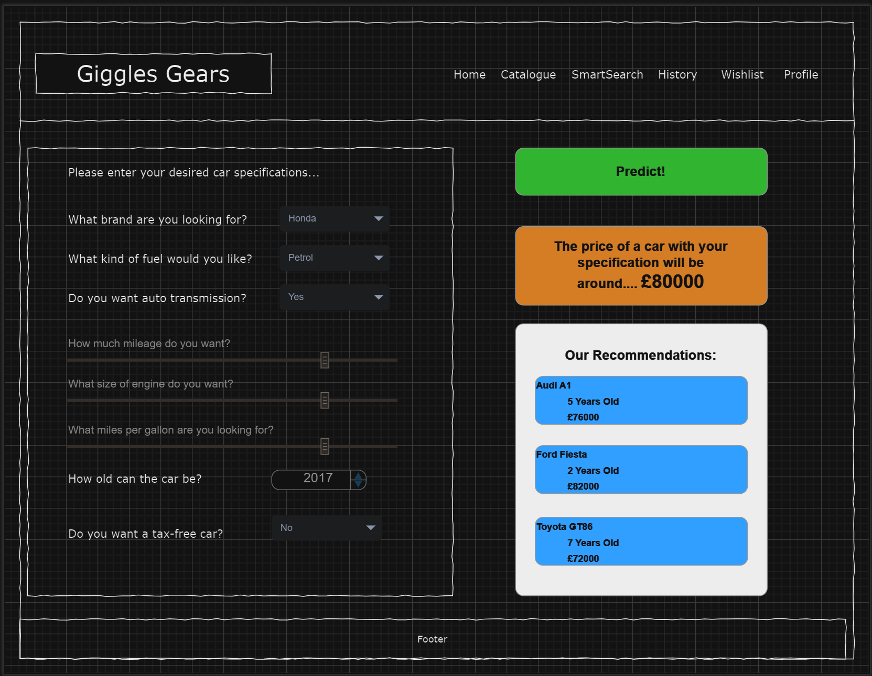
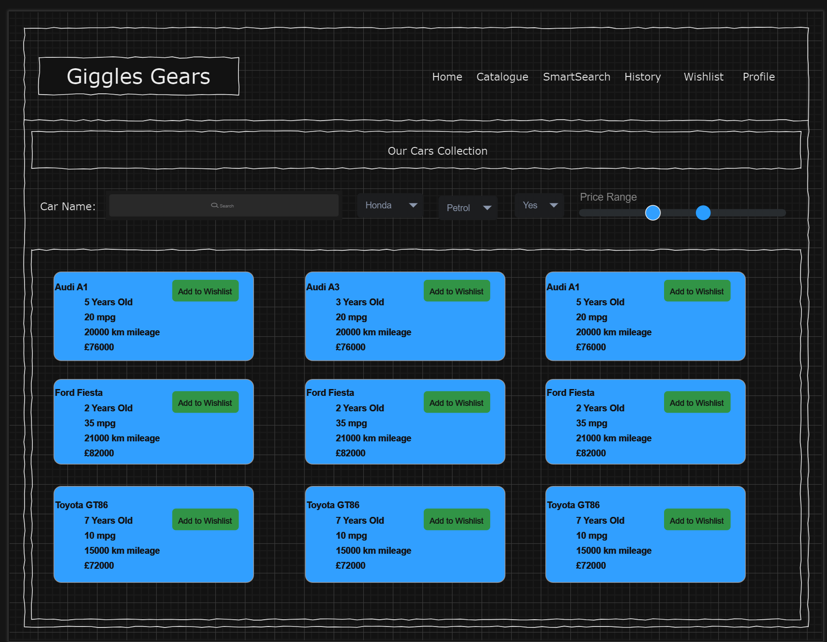
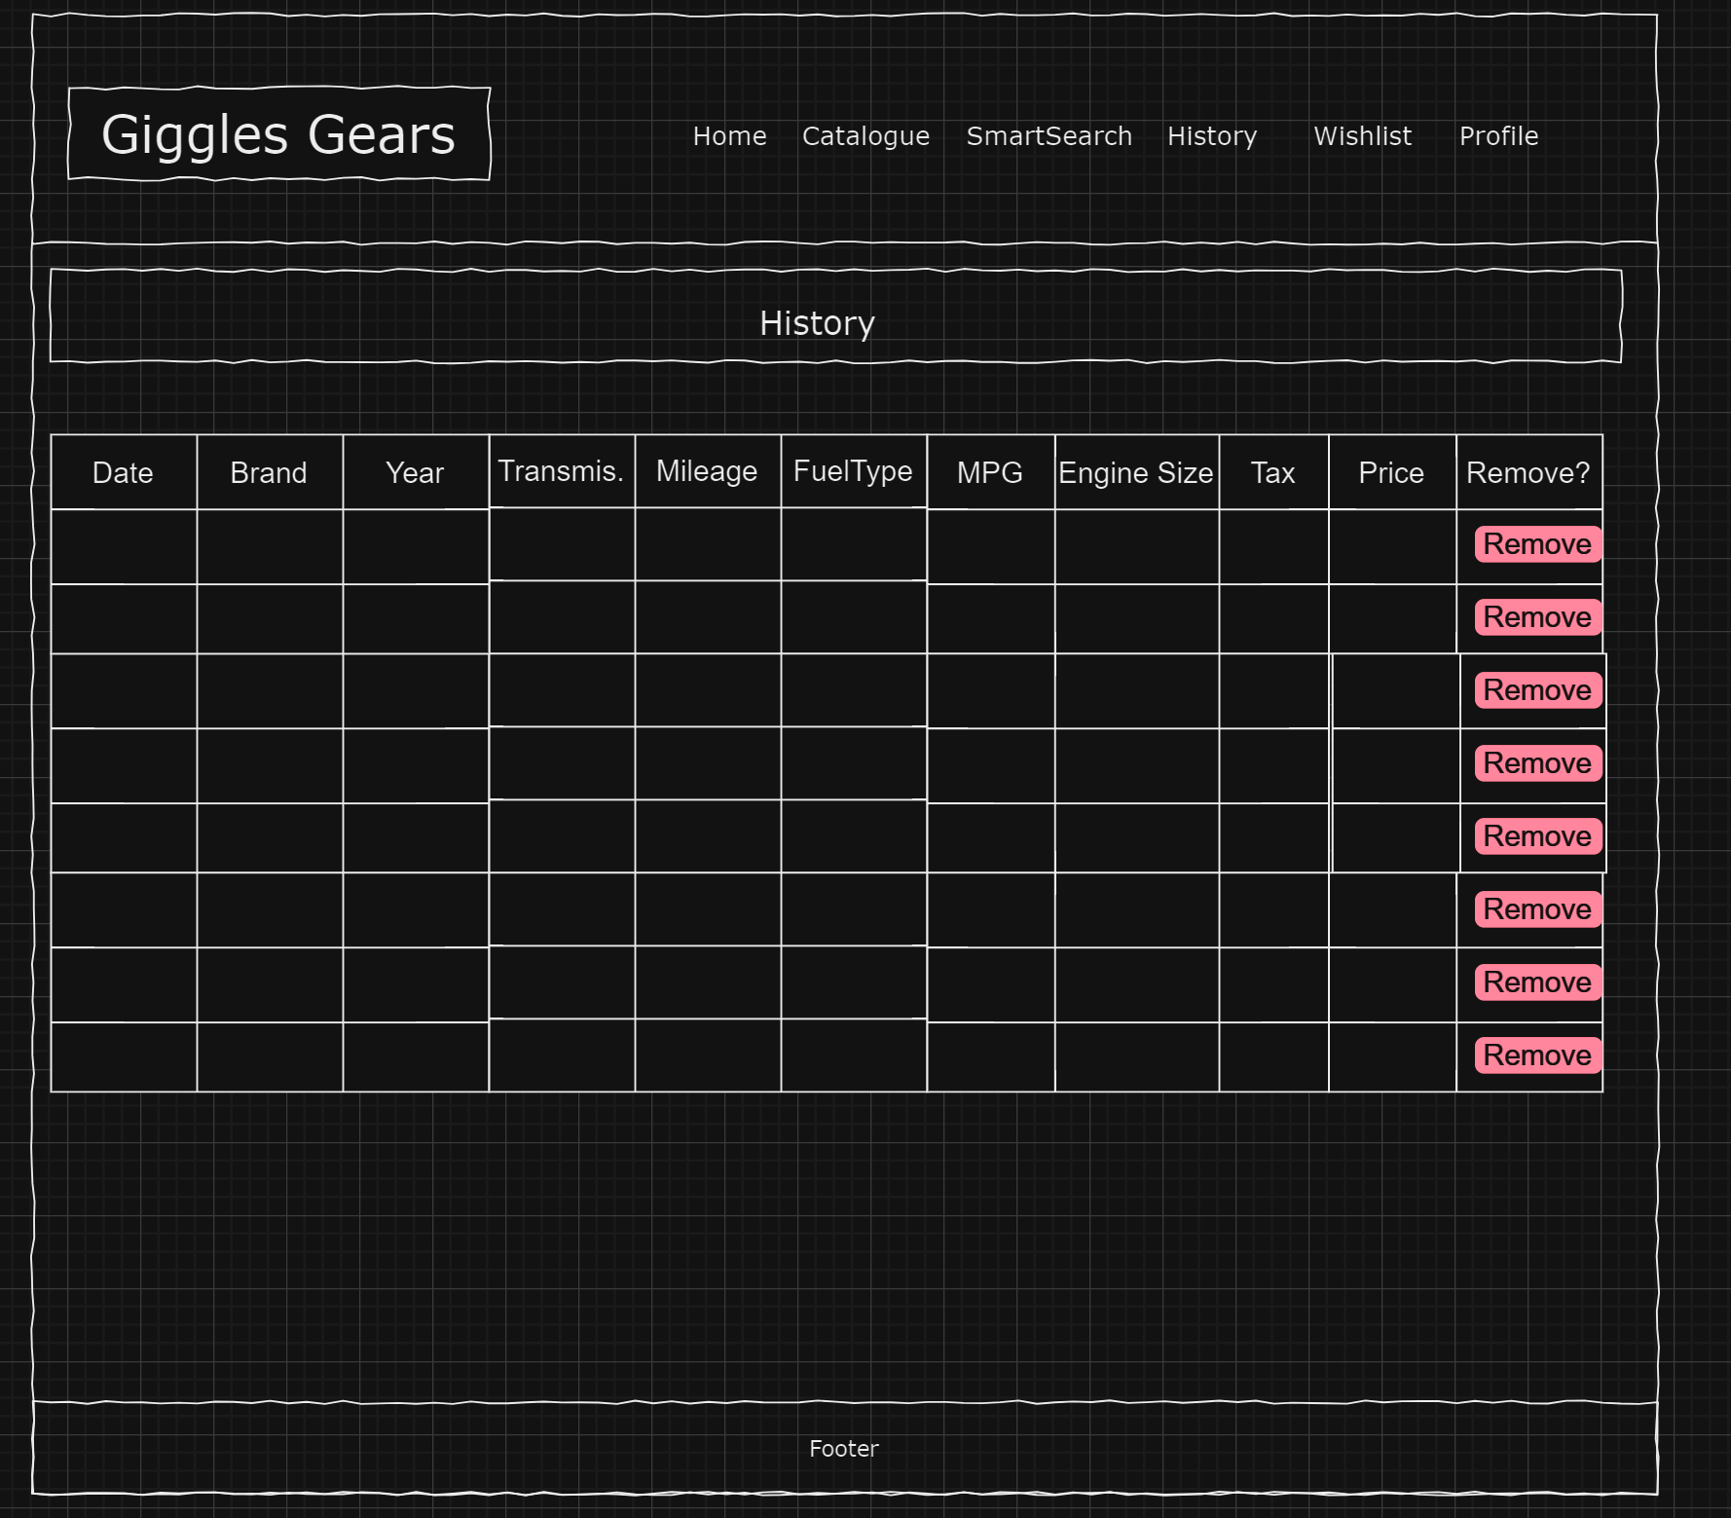
Wireframes

Slide 17
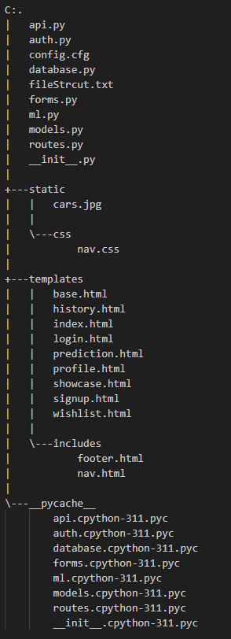
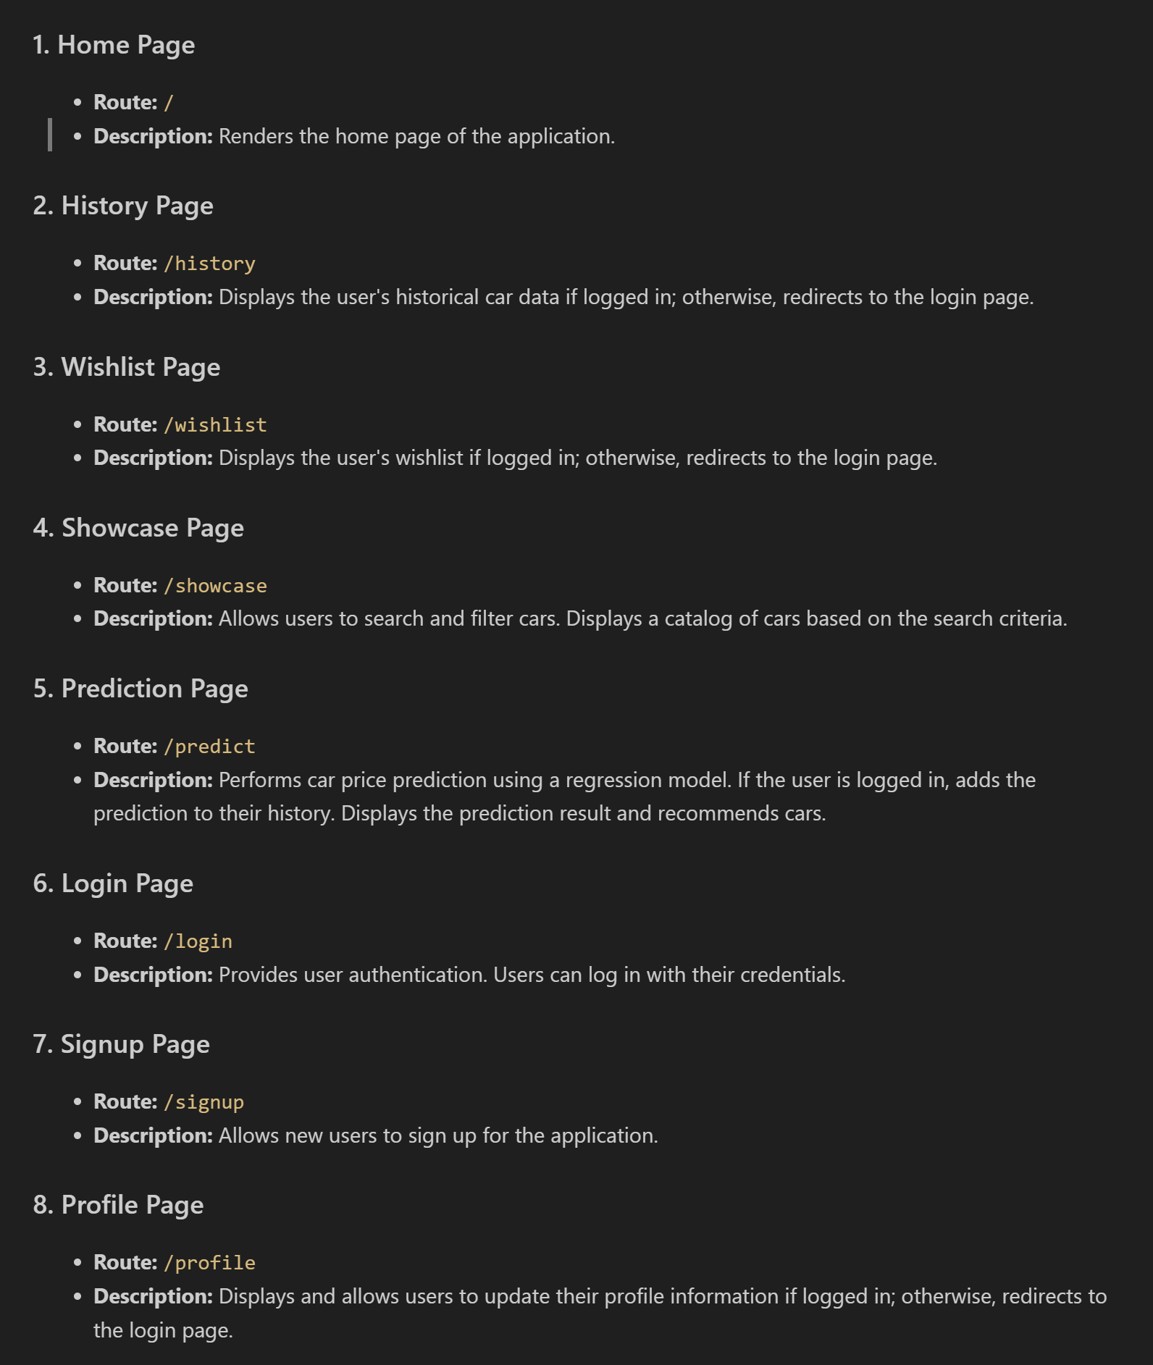
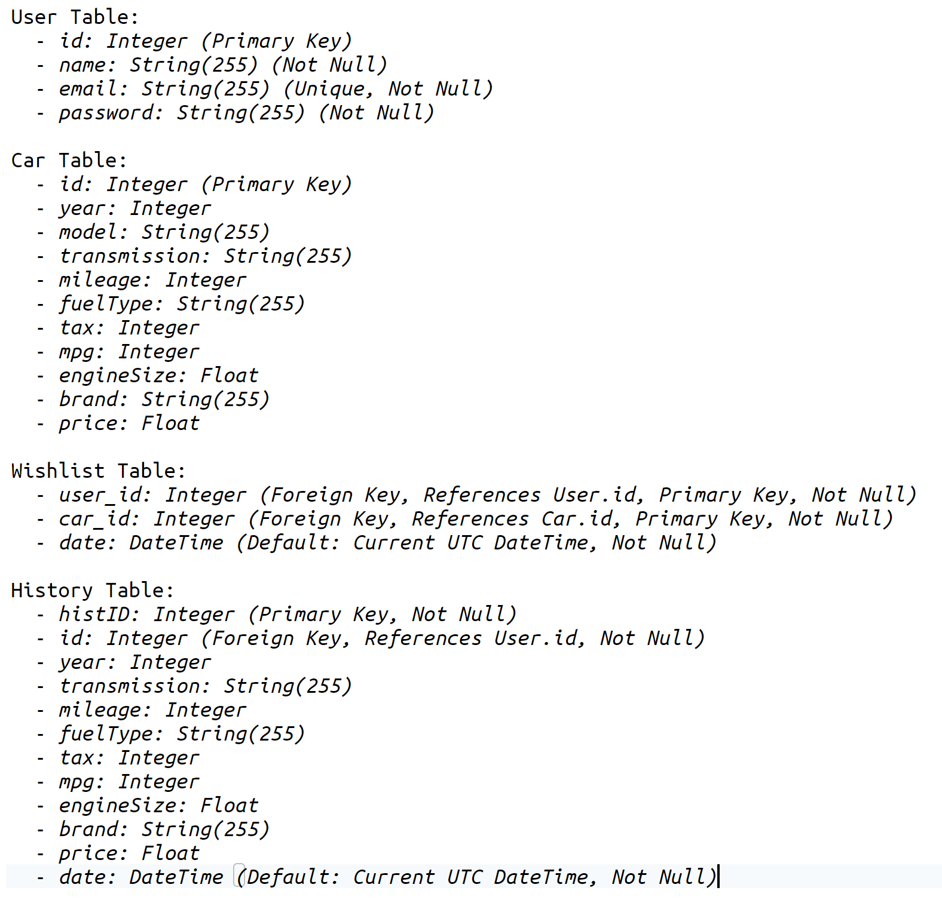
Flask App Setup
I used Flask-Login for user management and Flask-Bcrypt for hashing passwords
Application Structure
Routes
Database Schema

Slide 18
05
Testing

Slide 19
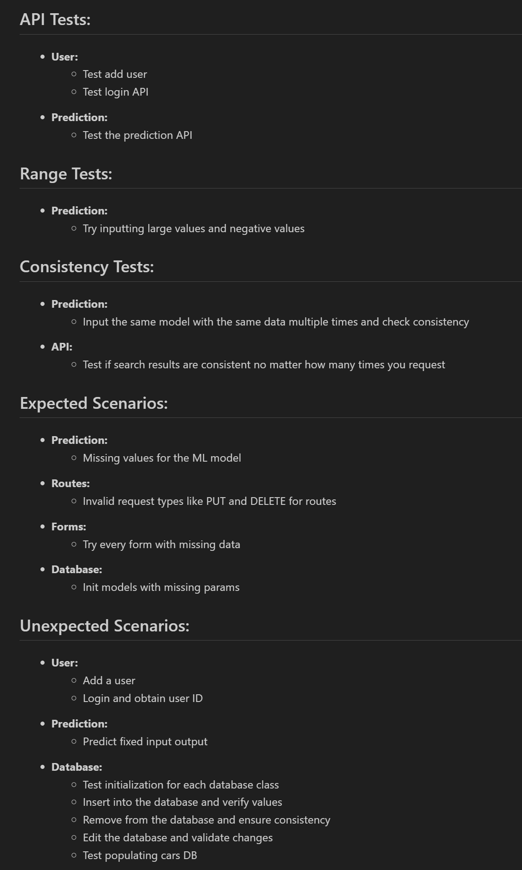
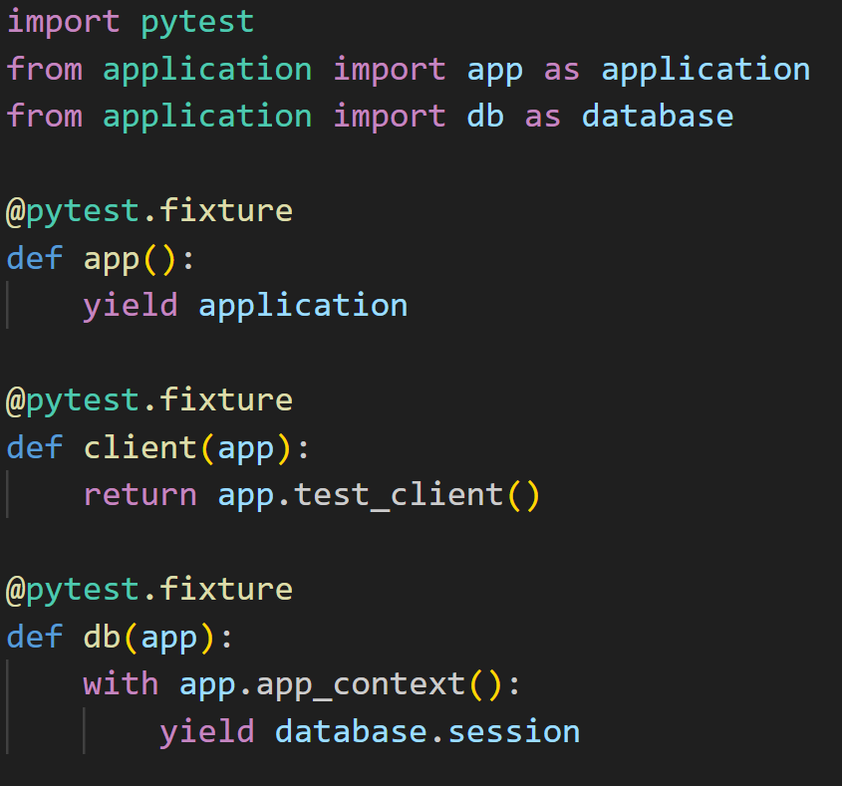
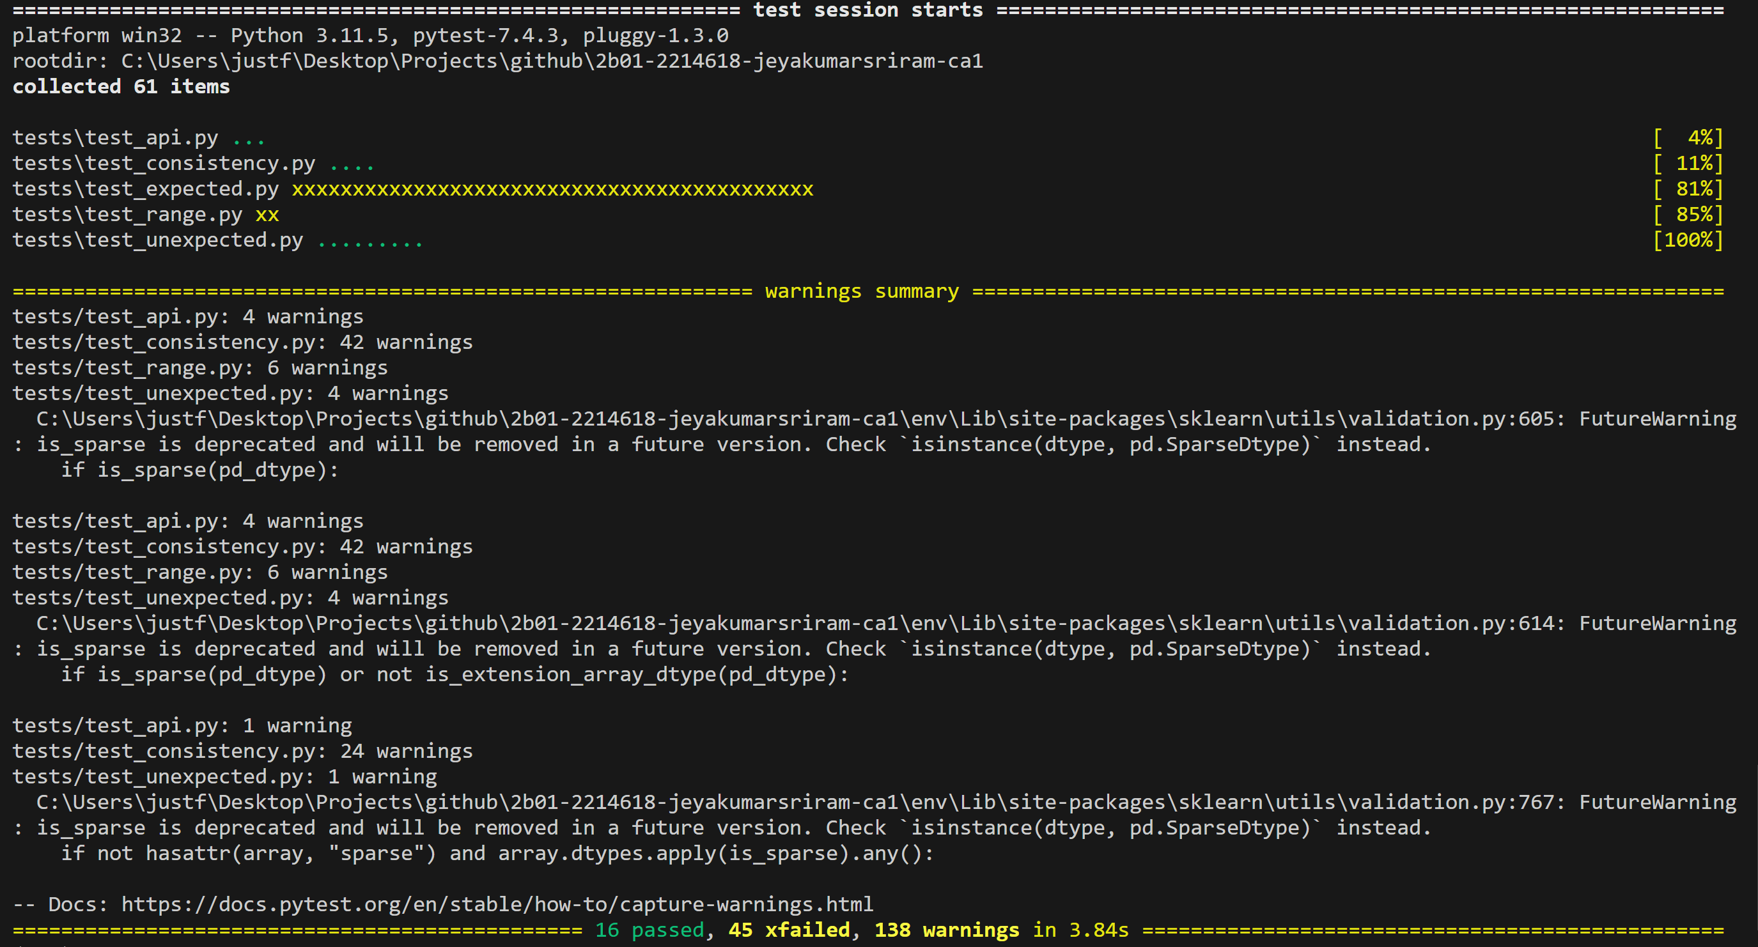
Tests (Overview)
I used simple fixtures in my application. I group all the tests in different files based on what they are testing for like range or consistency.
All the passable tests have passed and the rest xfailed. You can ignore the warning as they are future warning about a sklearn function getting deprecated
I did validity testing too but they are spread out between the diff files cuz its hard to separate them

Slide 20
06
Advanced

Slide 21
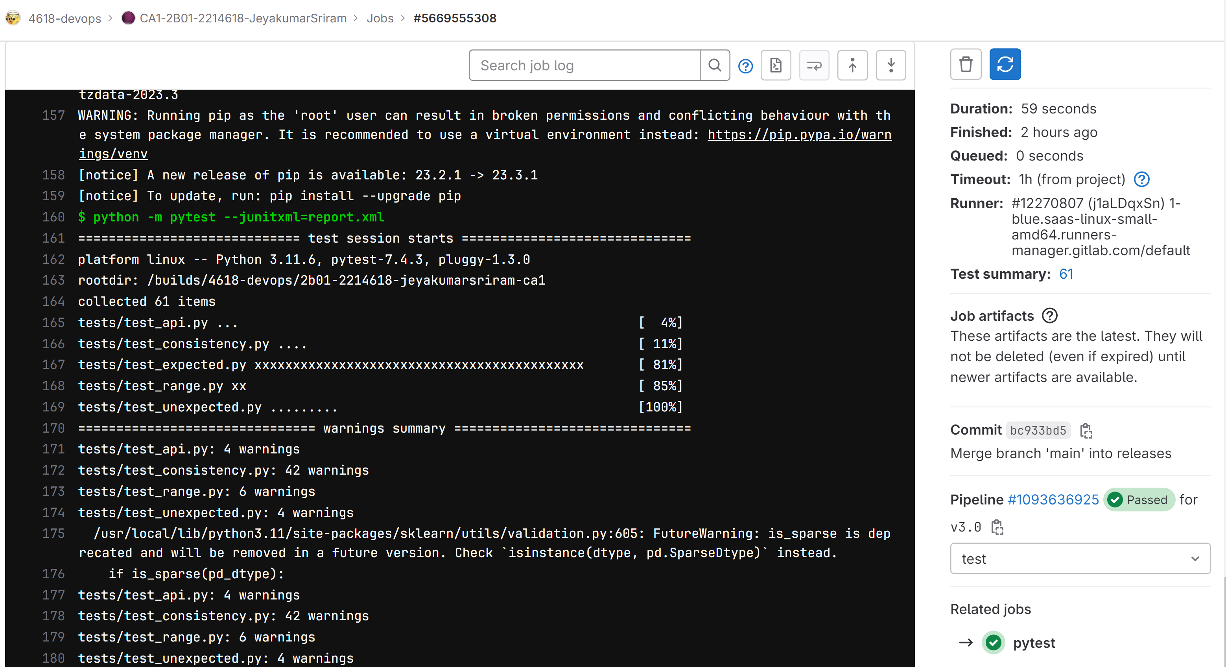
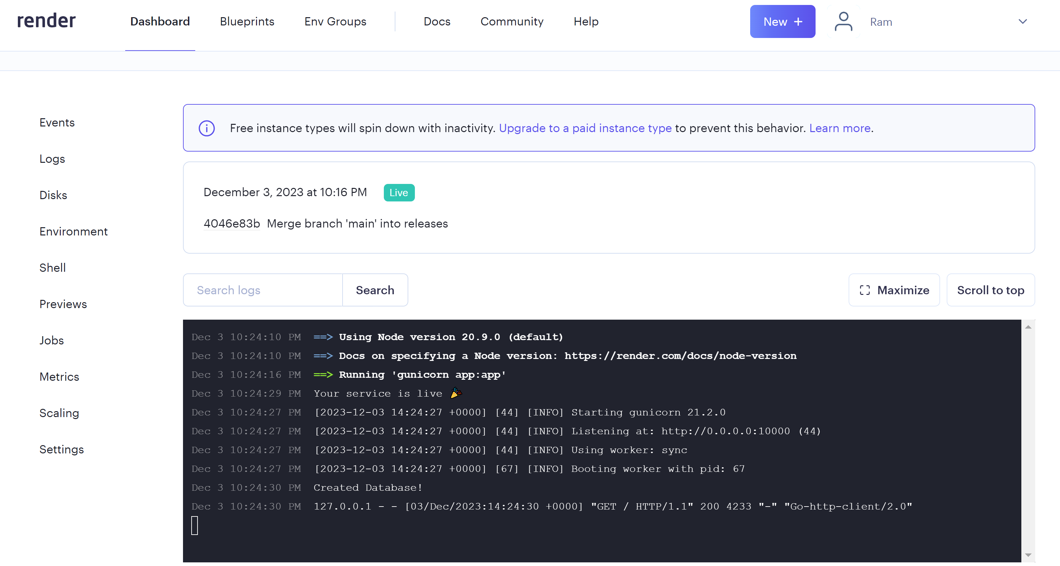
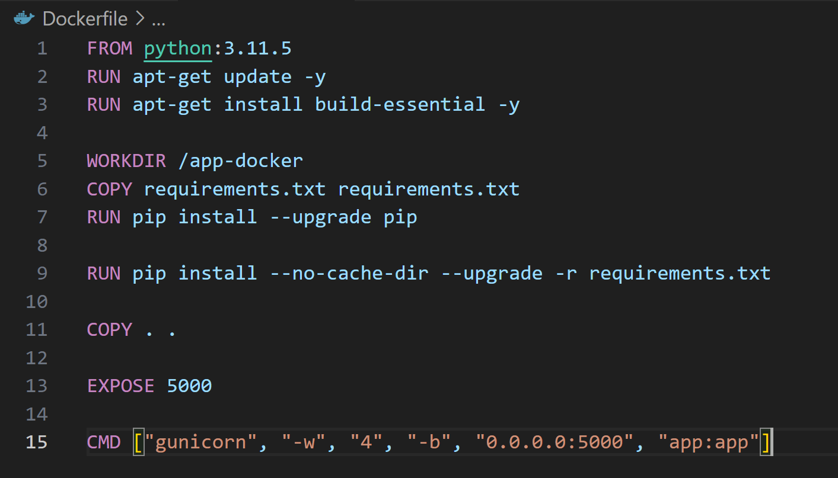
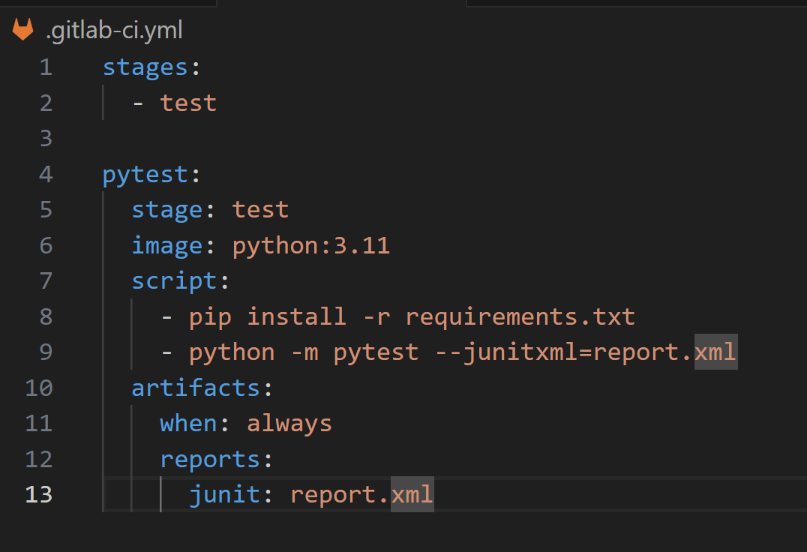
Advanced
Automatic Testing: I used gitlab’s CI pipeline feature to construct one that has just one stage which is testing. Basically whenever I merge a branch or commit the tests I’ve created will be run and produce a report like this =>>>
Dockerise: throughout my development I used docker to avoid touching my local environment. Using gunicorn
Deployed to Render.com using GitLab. Initially I tried to deploy my image to dockerhub and then to render but to make things simpler I just connected my render to my releases branch to deploy every release

Slide 22
Thanks!
Do you have any questions?
youremail@freepik.com
+34 654 321 432
yourwebsite.com
Please keep this slide for attribution

